Slide 1
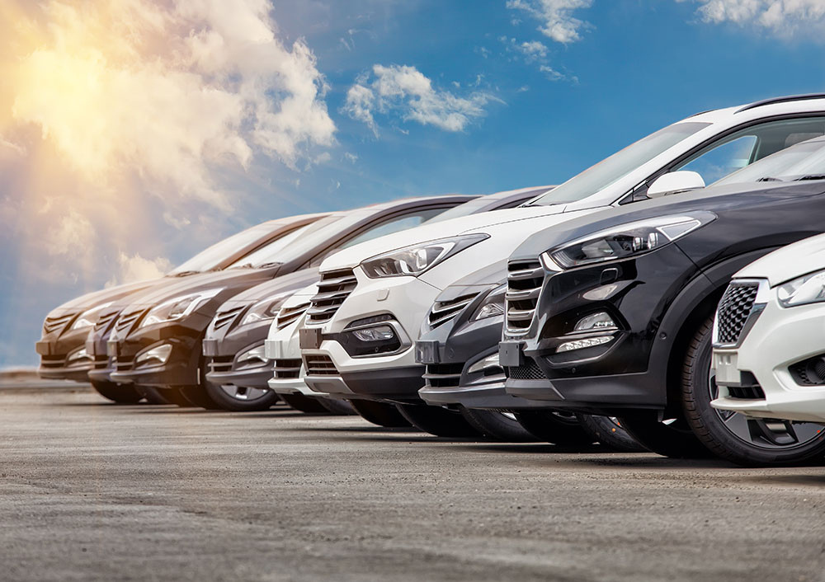
GROUP 4
USED CARS
DATA ANALYSIS
NAMES: ALI JAAFAR - HUSSAIN ALI - ISLAM NASSER

Slide 2
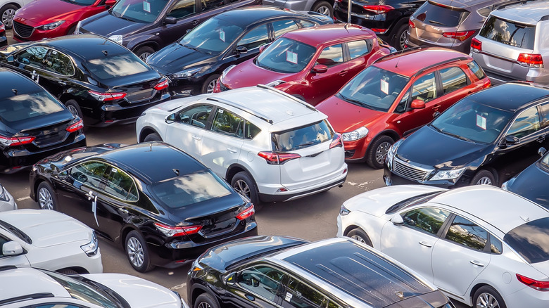
INTRODUCTION

Slide 3
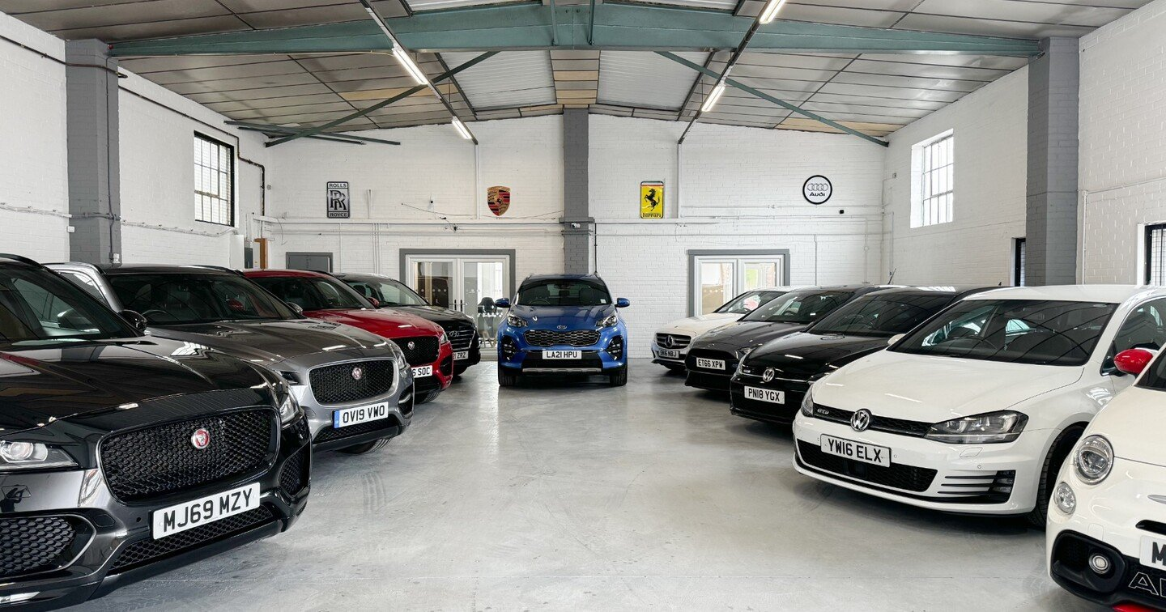
A.E.H
Auto Express Heaven
At AEH, we specialize in offering pre-owned vehicles that combine reliability, affordability, and peace of mind. Unlike traditional used car dealers, we meticulously inspect every car in our inventory to ensure it meets strict quality standards, so our customers drive away with confidence.

Slide 4
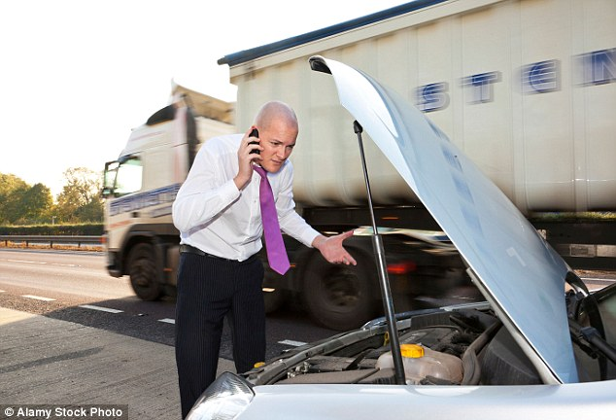
PROBLEM STATMENT

Slide 5
DIFFICULTY IN IDENTIFYING HIGH-DEMAND CAR MODELS.
HIGH INVENTORY TURNOVER TIME.
INACCURATE PRICING LEADING TO LOW PROFITABILITY.

Slide 6
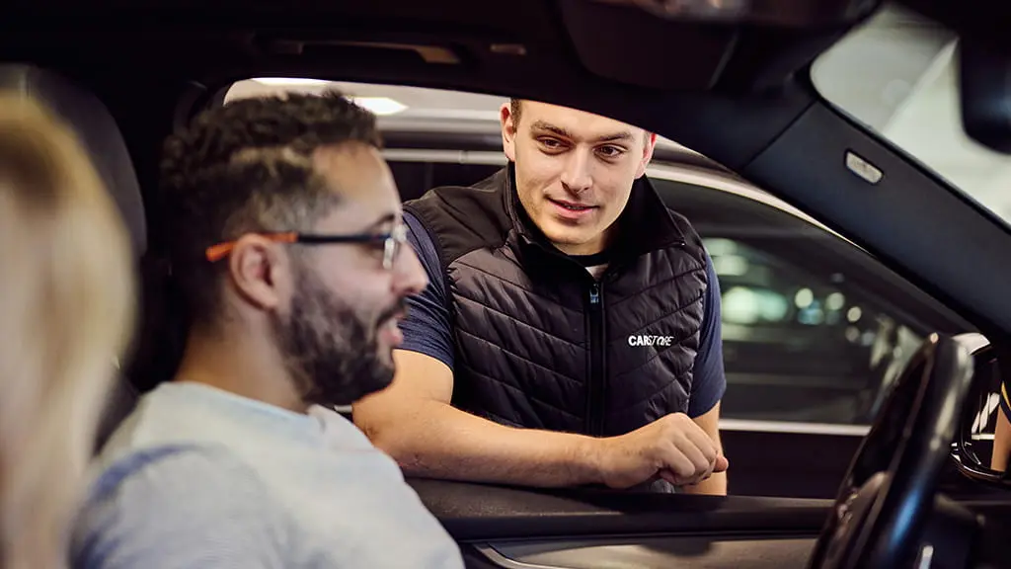
AIM

Slide 7
To find the most and least popular cars
and
Compare it to what we have in tha dataset
Use the data to improve sales, inventory management, customer satisfaction and profit.

Slide 8
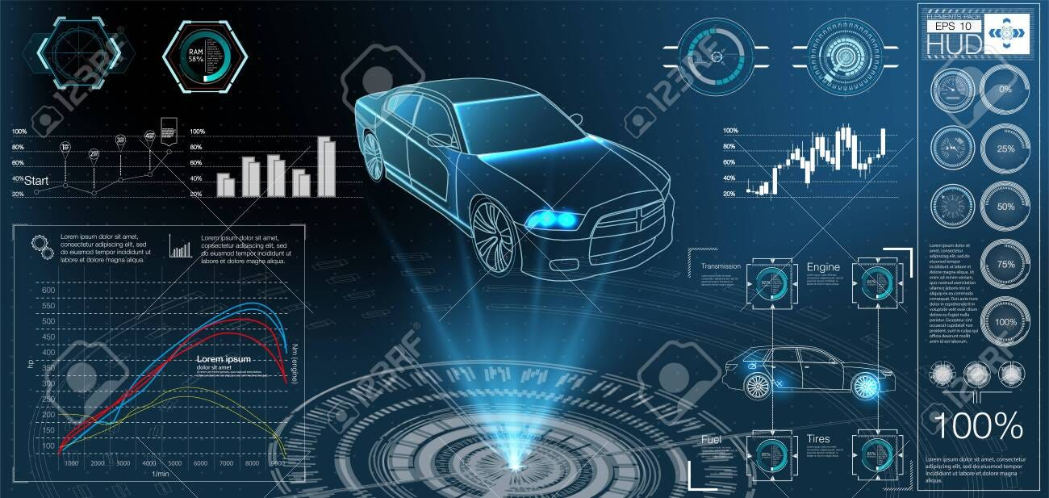
DATA ANALYSIS

Slide 9
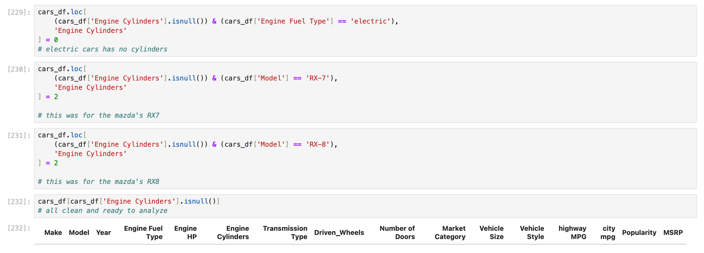
clean clean clean

Slide 10
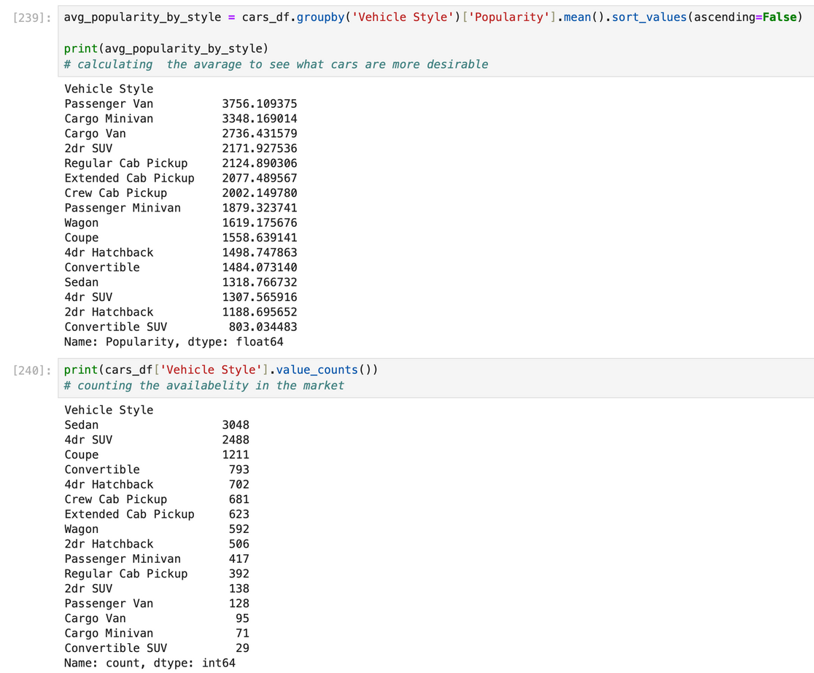
what we have ?

Slide 11

KEY FINDINGS

Slide 12

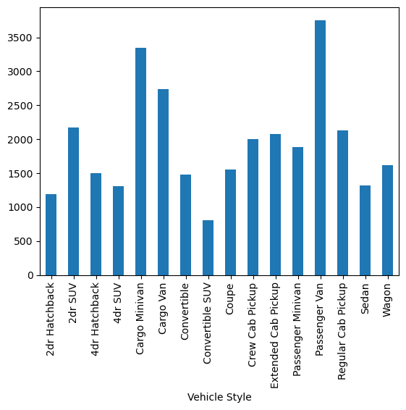
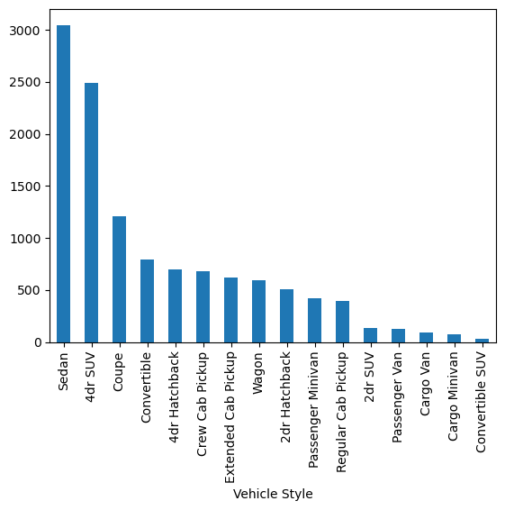
Mean popularity
Availability in market

Slide 13
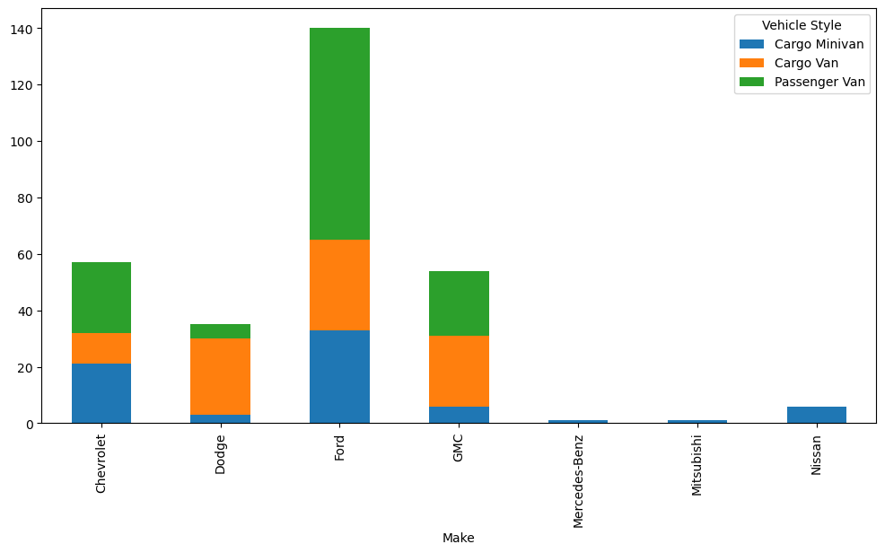
Going with what has all what we want

Slide 14
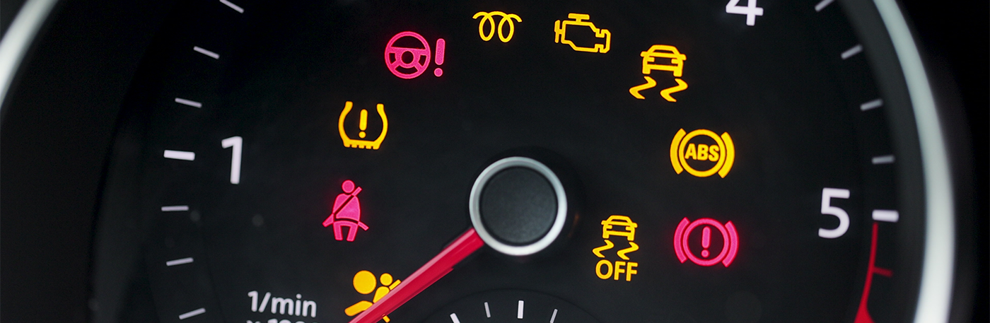
LIMITATIONS

Slide 15
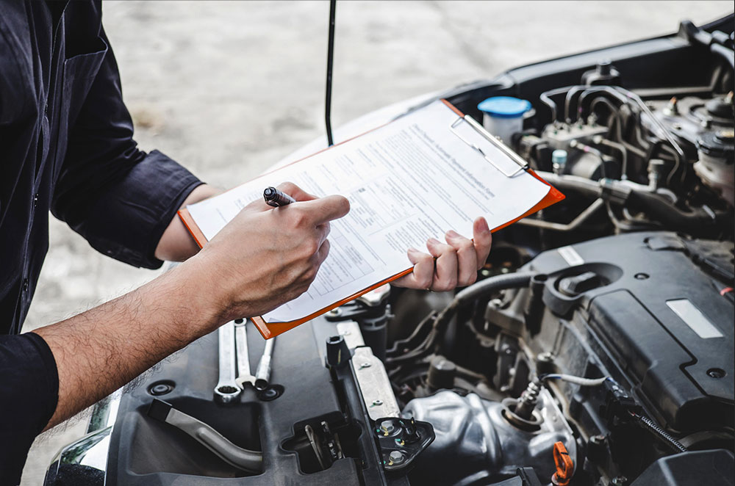
Data Incompleteness
Acceidnt reports
Repariment report
Market price
price difference between agencies
customer review
Mileage

Slide 16


THANK YOU
FOR YOUR ATTENTION

Slide 17

Any Q????

